Slide 1
a
square

Slide 2
a
star

Slide 3
a
circle

Slide 4
a
triangle

Slide 5
a
rectangle

Slide 6

it's
sunny

Slide 7

it's
raining

Slide 8

it's
cloudy

Slide 9
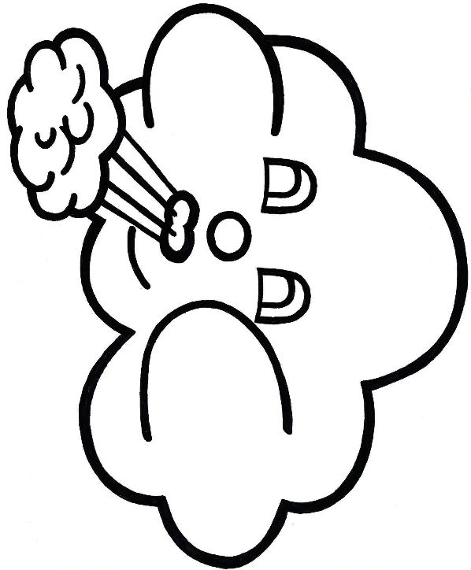
it's
windy

Slide 10

it's
stormy

Slide 11

it's
snowing

Slide 12
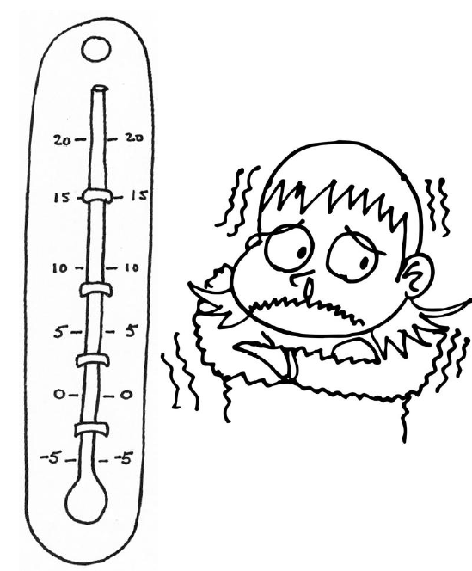
it's
cold

Slide 13
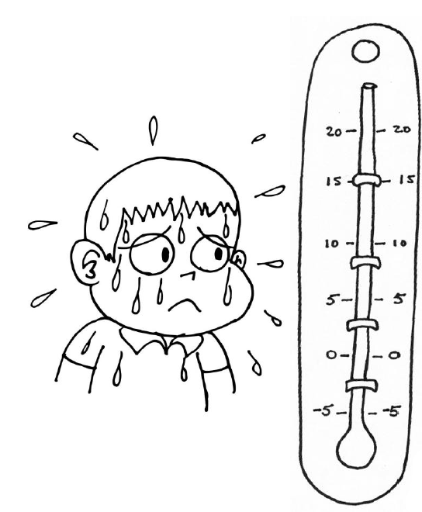
it's
hot

Slide 14
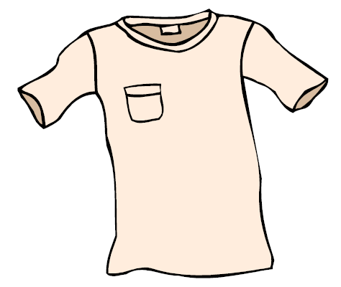
a
t-shirt

Slide 15
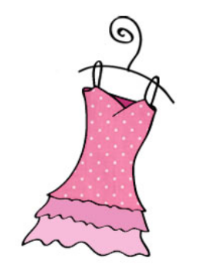
a
dress

Slide 16
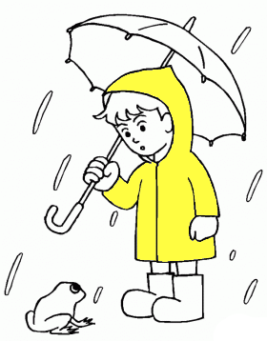
a
raincoat

Slide 17
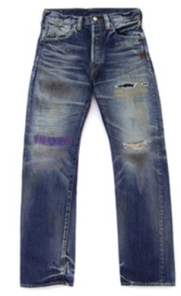
jeans

Slide 18

socks

Slide 19
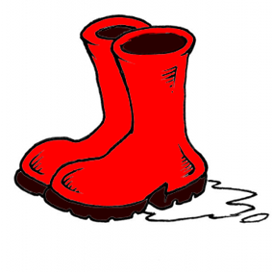
boots

Slide 20
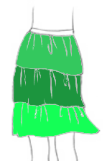
a
skirt

Slide 21
shoes

Slide 22
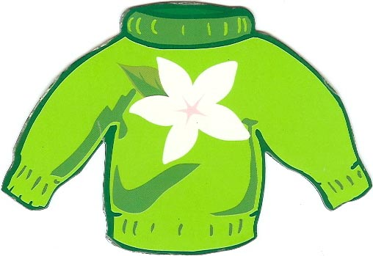
a
pullover

Slide 23
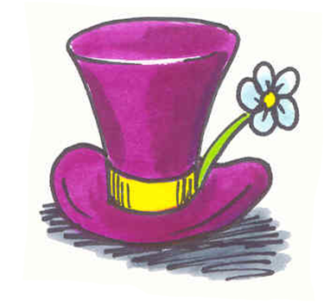
a
hat

Slide 24
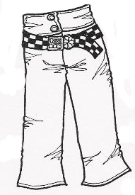
trousers

Slide 25
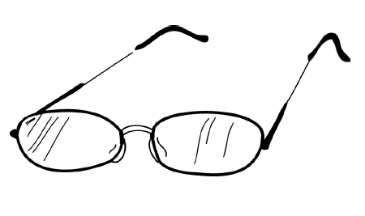
glasses

Slide 26
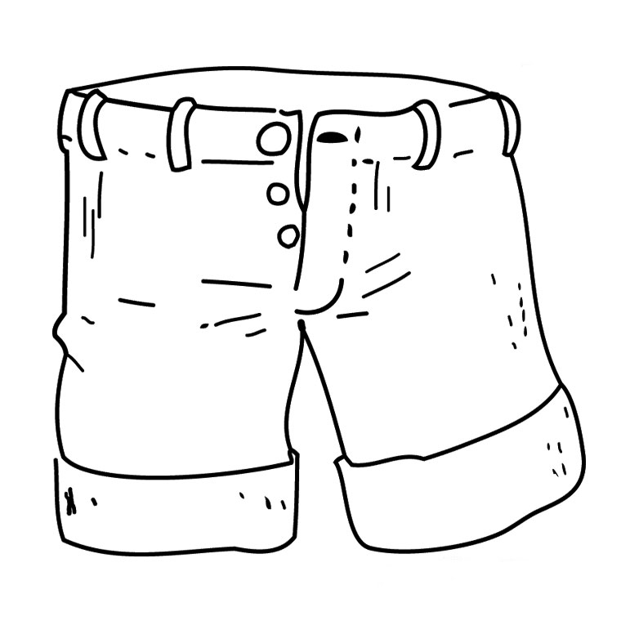
shorts

Slide 27
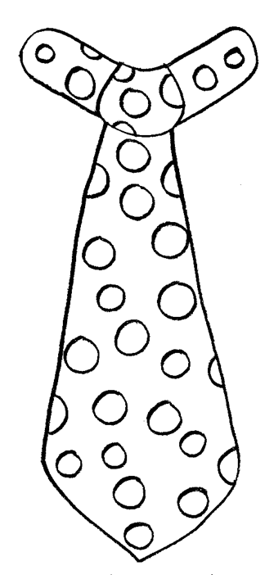
tie

Slide 28
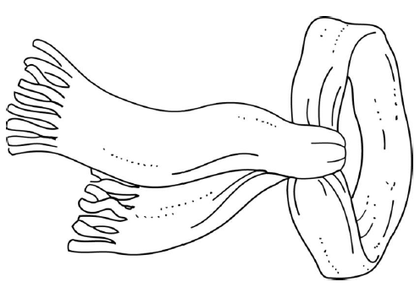
scarf

Slide 29
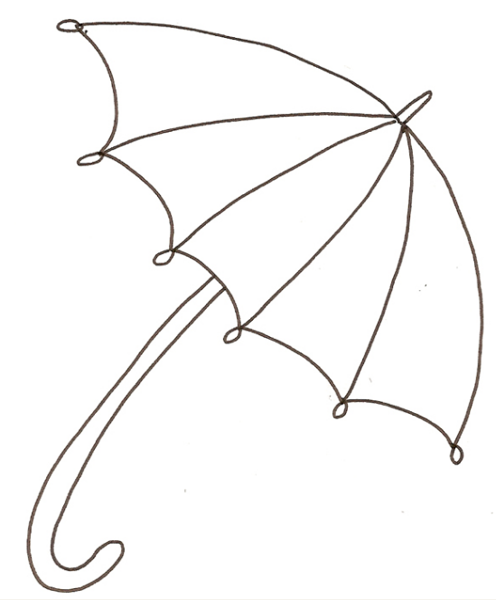
an
umbrella

Slide 30
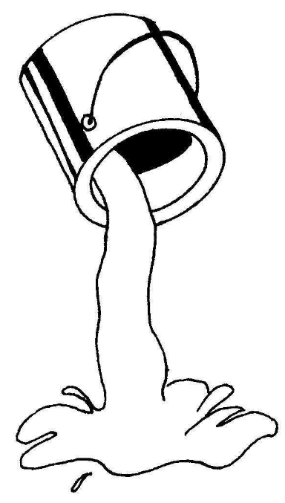
red

Slide 31
orange

Slide 32
yellow

Slide 33
purple

Slide 34
green

Slide 35
blue

Slide 36
pink

Slide 37
brown

Slide 38
black

Slide 39
grey

Slide 40
white

